Slide 1
Fault Tolerance
Basic Concepts
  Being fault tolerant is strongly related to what are called dependable systems.
  Dependability is the trustworthiness of a computer system
  The designer of a distributed system should take into consideration that services may fail in a variety of ways and seek to minimize the risk of failures by assuming that unlikely events that cause failure will occur at the worst possible times.

Slide 2
Fault Tolerance
Dependability is a term that covers a number of useful requirements for distributed systems including the following
  1. Availability
  2. Reliability
  3. Safety
  4. Maintainability

Slide 3
Fault Tolerance
Availability
  Property that a system is ready to be used immediately.
  In general, it refers to the probability that the system is operating correctly at any given moment and is available to perform its functions on behalf of its users.
  In other words, a highly available system is one that will most likely be working at a given instant in time.

Slide 4
Fault Tolerance
Reliability
  Property that a system can run continuously without failure.
  In contrast to availability, reliability is defined in terms of a time interval instead of an instant in time.
  A highly reliable system is one that will most likely continue to work without interruption during a relatively long period of time.
  If a system goes down for one millisecond every hour, it has an availability of over 99.9999 percent, but is still highly unreliable.
  Similarly, a system that never crashes but is shut down for two weeks every August has high reliability but only 96 percent availability.

Slide 5
Fault Tolerance
Safety
  Situation that when a system temporarily fails to operate correctly, nothing catastrophic happens.
  Many process control systems, such as those used for controlling nuclear power plants or sending people into space, are required to provide a high degree of safety.
  If such control systems temporarily fail for only a very brief moment, the effects could be disastrous

Slide 6
Fault Tolerance
Maintainability
  How easy a failed system can be repaired.
  A system is said to fail when it cannot meet its promises
  An error is a part of a system’s state that may lead to a failure
  The cause of an error is called a fault. Finding out what caused an error is important, it is then relatively easy to remove the fault.

Slide 7
Fault Tolerance
Fault tolerance,
Meaning that a system can provide its services even in the presence of faults.
Faults are generally classified as
  Transient
  Intermittent
  Permanent.

Slide 8
Fault Tolerance
Transient
  Occur once and then disappear. If the operation is repeated, the fault goes away.
  A bird flying through the beam of a microwave transmitter may cause lost bits on some network.
  If the transmission times out and is retried, it will probably work the second time

Slide 9
Fault Tolerance
Intermittent fault.
  Occurs, then vanishes of its own accord, then reappears, and so on. A loose contact on a connector will often cause an intermittent fault.
  Intermittent faults cause a great deal of aggravation because they are difficult to diagnose.

Slide 10
Fault Tolerance
Permanent fault
  One that continues to exist until the faulty component is repaired.
  Burnt-out chips, software bugs, and disk head crashes are examples of permanent faults.

Slide 11
Design Approaches
Several design approaches are used to design dependable systems.
Interconnect for good reasons
  A complex web of interconnected sub-systems should be avoided. The more complex the web, the more fragile is the overall system.
  Interconnect only when defined objectives are meet by doing so

Slide 12
Design Approaches
Support only necessary services
  It is tempting to implement a wide variety of services by default, some of which may not be necessary.
  For security reasons and in order to minimize maintenance, services should only be implemented if there is need.
  An enabled service may represent an unwanted sub-system that may compromise the robustness of the entire system

Slide 13
Design Approaches
Include self-diagnosis and authentication mechanism
  A distributed system should attempt to monitor itself, identify any inconsistencies and gracefully shutdown any faulty components and restart or switch to a replica.
  Clients should be authenticated to avoid malicious failures

Slide 14
Design Approaches
Design for fault tolerance
  By assuming that failures will occur, we are lead to a design systems that are fault tolerant to some classes of failures.
  A fault tolerant system is one that will continue to operate as required in the presence of faults

Slide 15
Design Approaches
Design for scale
  When designing distributed systems, take into consideration the fact that major performance problems can arise when the number of users or components grows to a large number.
  Scale should be a design parameter rather than a capacity planning exercise after system development.

Slide 16
Design Approaches
Avoid mechanisms that cascade failures
  In systems under heavy workloads or when some failures occur, failures can cascade as other mechanisms are activated

Slide 17
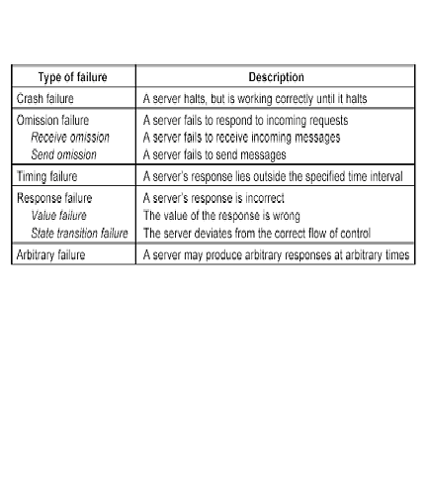
Typical failure classification scheme

